Slide 1
Domain Model Exercise
(2-3 hours)

Slide 2
Exercise
Goal: drawing domain model
Team arrangement
  Please create an ad hoc team with your friends
    You are encouraged (but not required) to form an ad hoc team with your project teammates
  Each team should have 3-4 students
    Teamwork is required.
  Move your desks to allow easy discussion

Slide 3
Exercise
You are required to
  Draw a domain model on an A4 paper (or on a computer)
    Use a digital camera (phone) to capture your domain model
    Show the results only, omit the steps/process.
  Your drawing should include concepts (classes), attributes, associations, association names, and multiplicity
  You have 60-80 minutes to draw your domain model
  A team will be selected to show your domain model to your classmates in the class

Slide 4
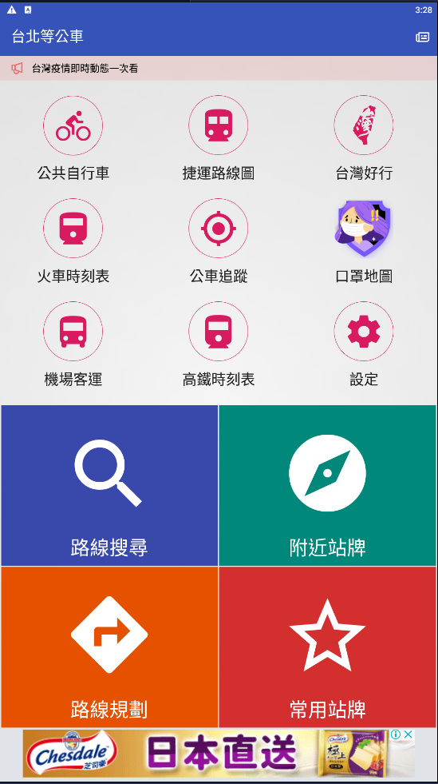
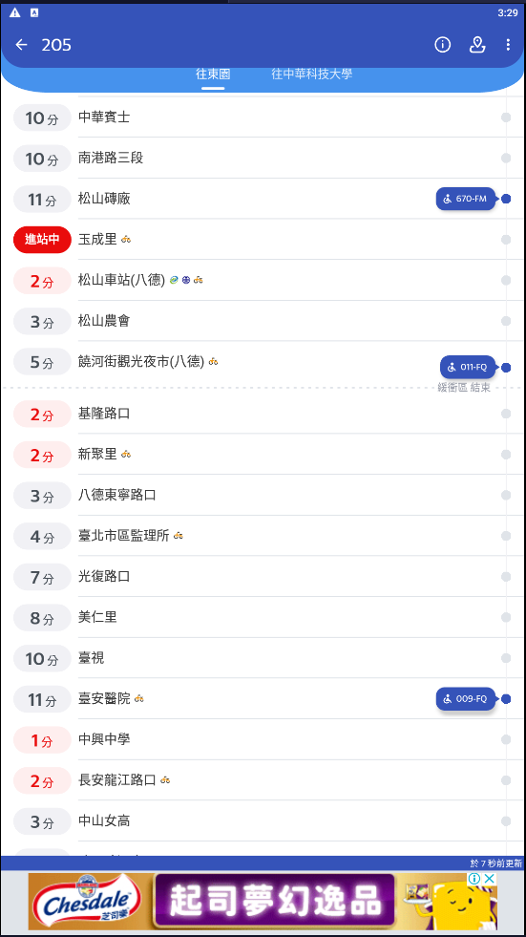
Exercise
Target App: 台北等公車(Google Play or App Store)
  路線規劃 (Plan Route)
    選擇起點、終點，搜尋路線，選擇路線，查看公車路線
  常用站牌(Add Favorite)
    新增常用站牌群組，加入常用站牌，選擇前往路線，查看公車路線
Upload deadline: Upload your domain model to Teams before 5/21 23:59PM

Slide 5
Exercise – List of nouns for reference
FavoriteGroup | 常用站牌群組
User | 使用者
TravelPlan | 旅行規劃
BusTable | 公車表
Route | 路徑
Name | 名稱
Price | 價格
Message | 訊息
WalkRoute | 走路路徑
BusRoute | 公車路徑
Photo | 相片
Stop | 車站
Bus | 公車
Notice | 到站提醒
Favorite | 常用站牌
BusLine | 公車路線
Text | 文字
RouteMap | 路徑圖
Coordinate | 座標
StopAtTime | 到站時間
ArrivalTime | 抵達時間
Category | 總類
Section | 票價區間
Date | 日期
Share | 分享
Keyboard | 鍵盤
Scrollbat | 滾動條
SearchBar | 搜尋條
System | 系統
Controller | 控制器
Icon | 圖示
Menu | 選單
Video | 影像
Advertisement | 廣告
Setting | 設定
Timer | 計時器

Slide 6
Lessons Learned
Were the domain model designed by different teams the same?
Was a team better than a single person?
Which team created the “best” domain model?

